Slide 1
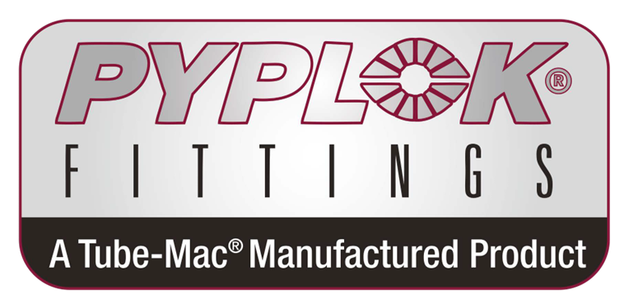
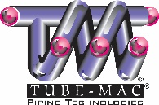
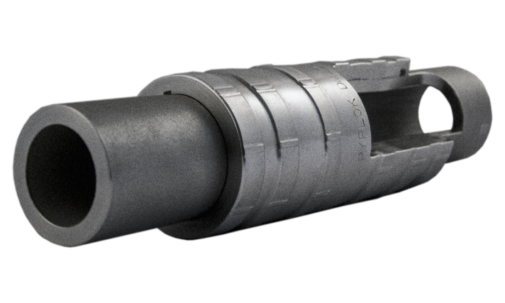
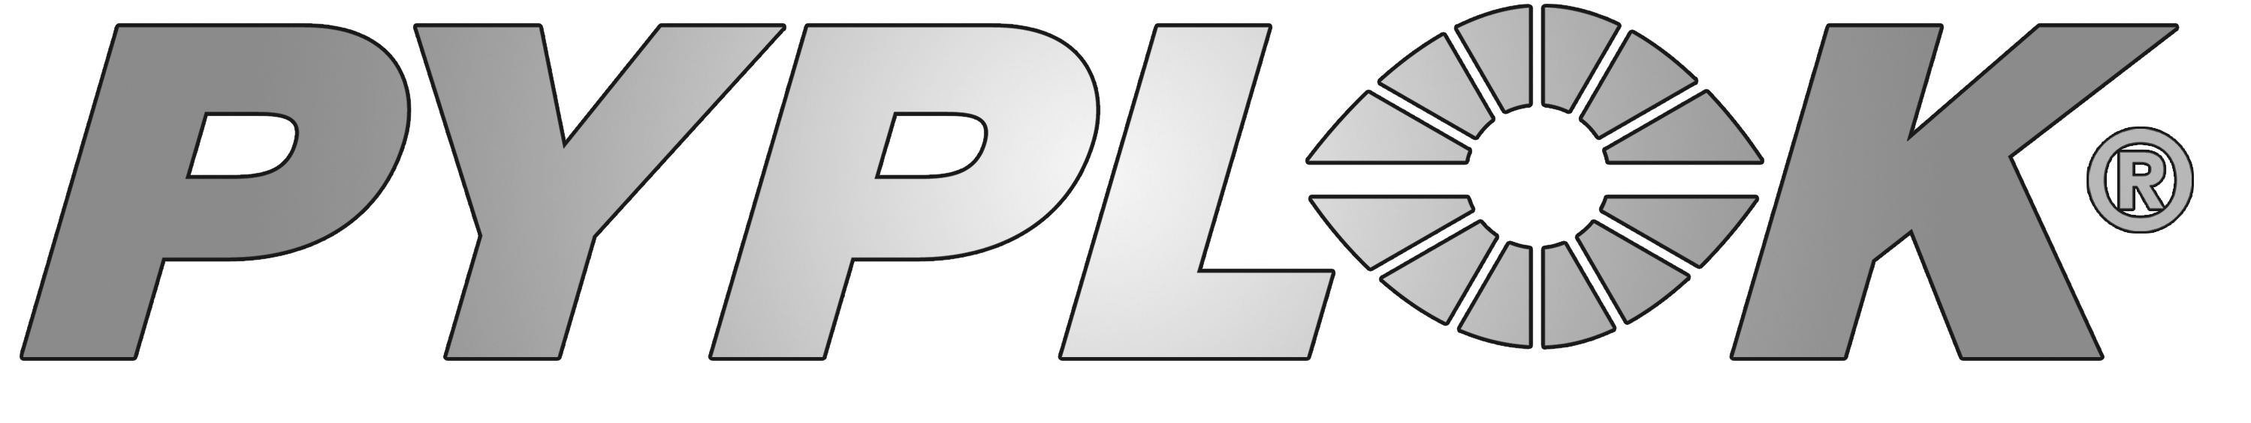
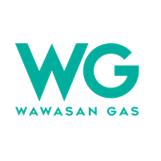
2025 Pyplok Global Distributor Meeting
Presenter:
Steve Chieng – Sales & Service Manager, Malaysia

Slide 2
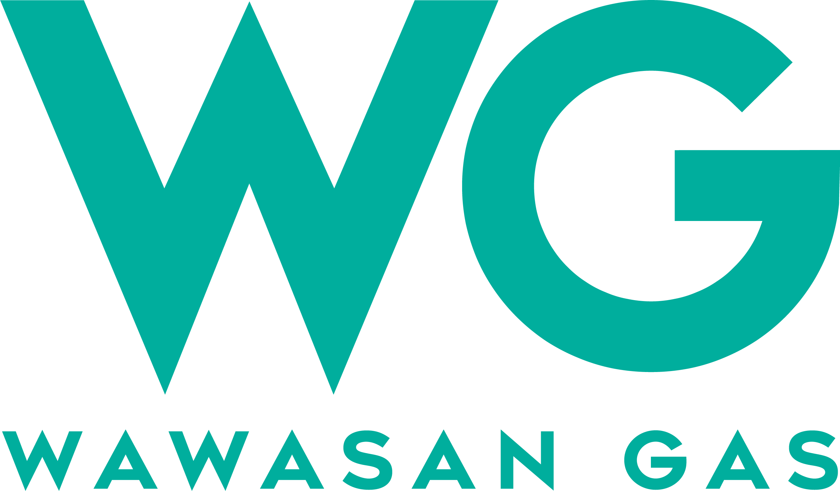

Agenda
Introduction of Wawasan Gas and HKK, Malaysia
Project Experience & Success Story
Company Direction & Strategy
Main Challenges
Q & A

Slide 3
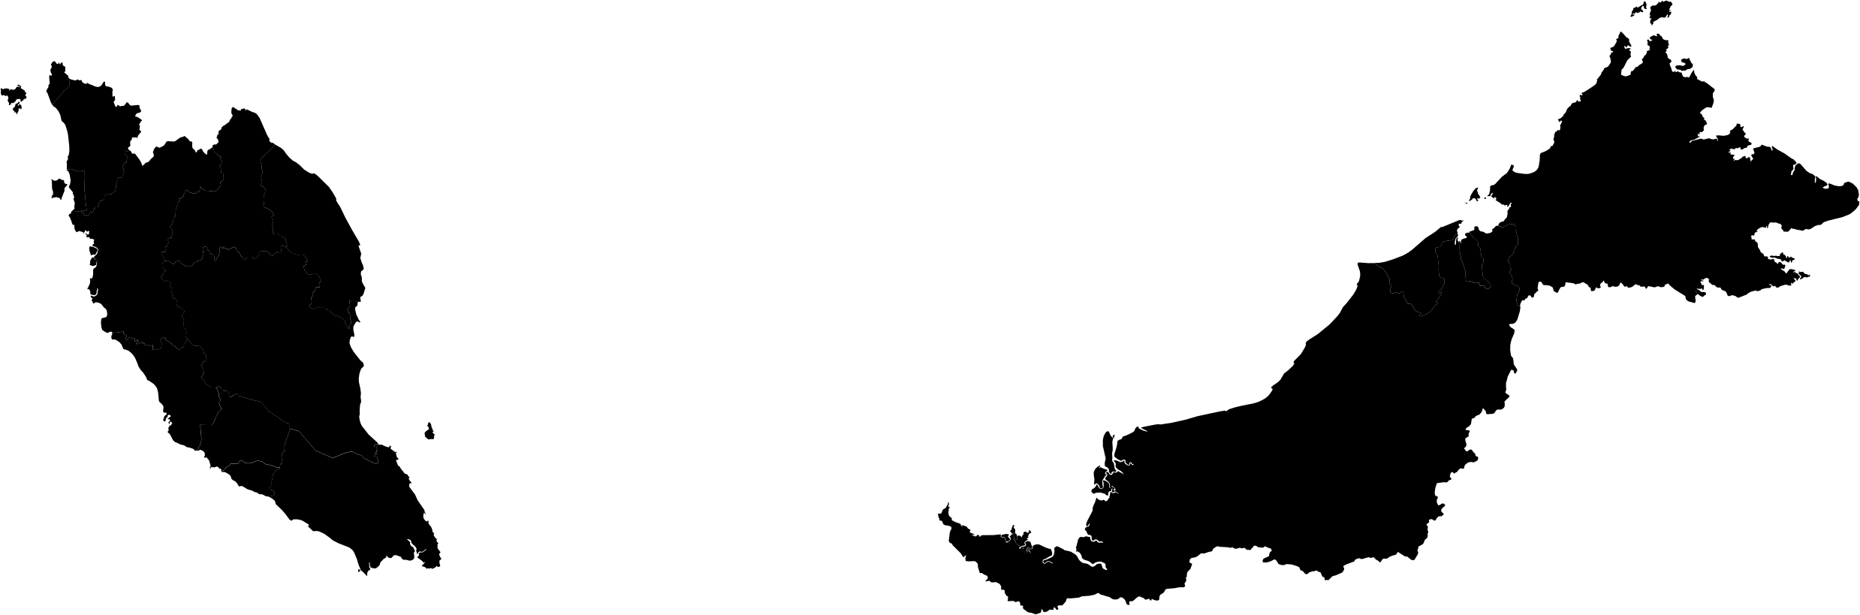

LOCATION
With our distribution across the nation,
WG/HKK is determined to serve our customers anywhere.
Sabah
Sarawak
East Coast
Bintulu
Selangor / KL
Johor

Slide 4

PYPLOK Application List in Malaysia
Customer | Application
Petronas MLNG, Bintulu | Started since 2019 with service contract for installation in service line like Steam, N2, Water, Hydrocarbon and etc
Petronas MRCSB, Melaka | Installed at steam line since 2019
Petronas Gas, GPP5, Santong | Installed at steam & hydrocarbon line since 2021
Lam Soom Edible Oil, Pasir Gudang | Installed at Hydrogen line since 2022
Vale Malaysia, Manjung | Installed at Hydraulic line since 2015
MMHE, Pasir Gudang | Installed at Hydraulic during marine repair since 2022
Hibiscus Malaysia | Installed at Offshore Utility Line since 2024

Slide 5
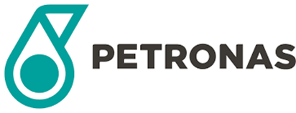
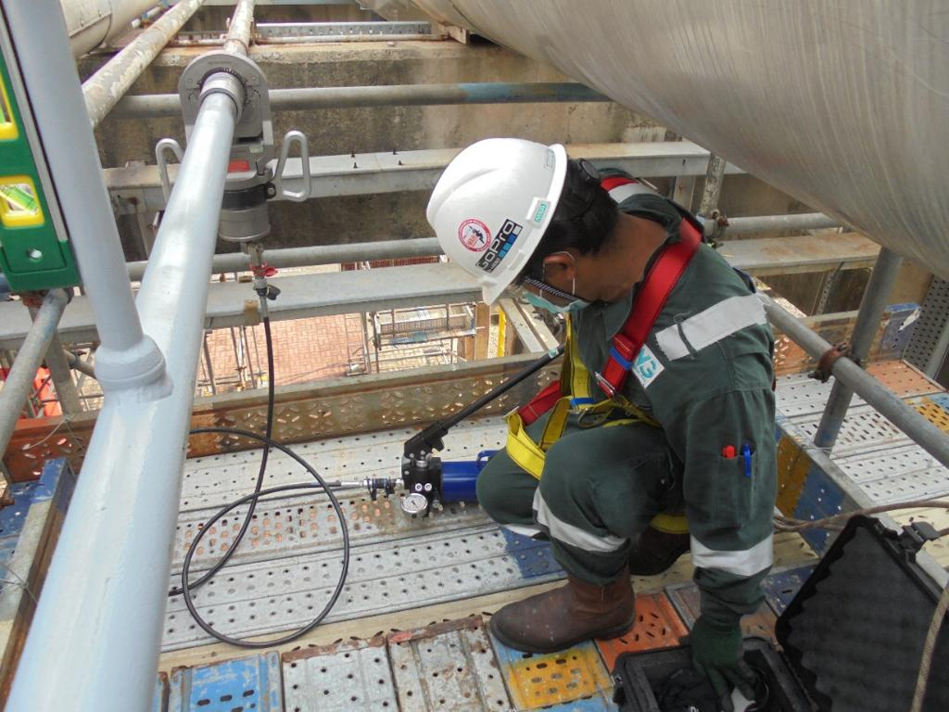
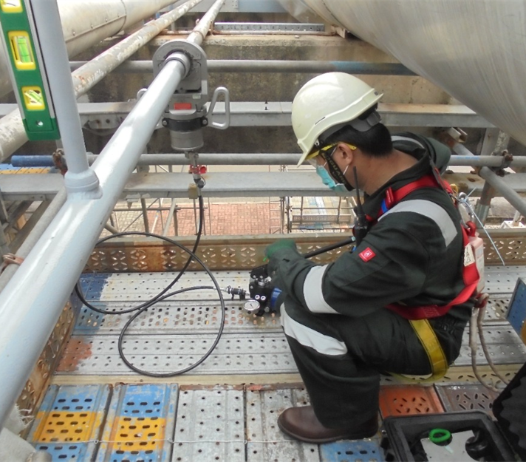
Contaminated Oil & Steam Lines
2” N.P.S. PYPLOK®, Carbon steel fittings for Steam Lines at Petronas Gas at Paka

Slide 6
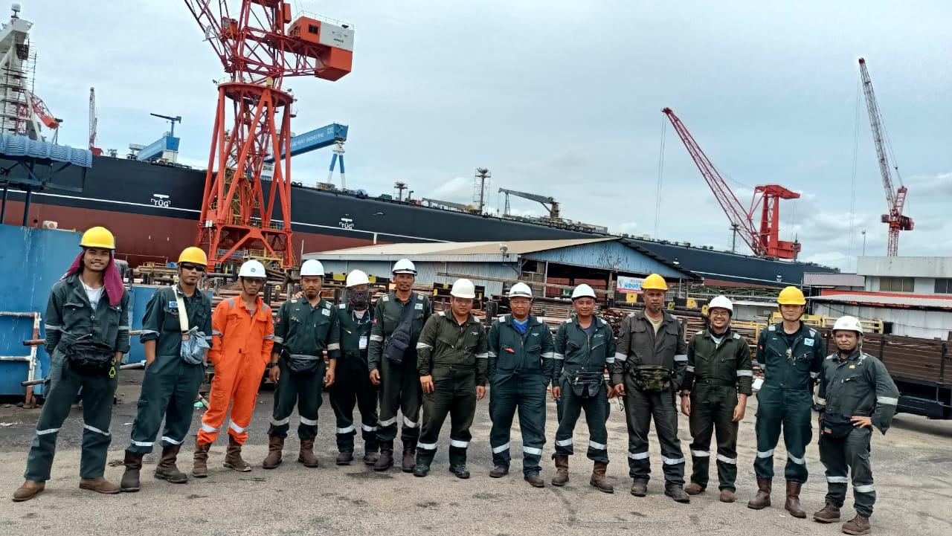
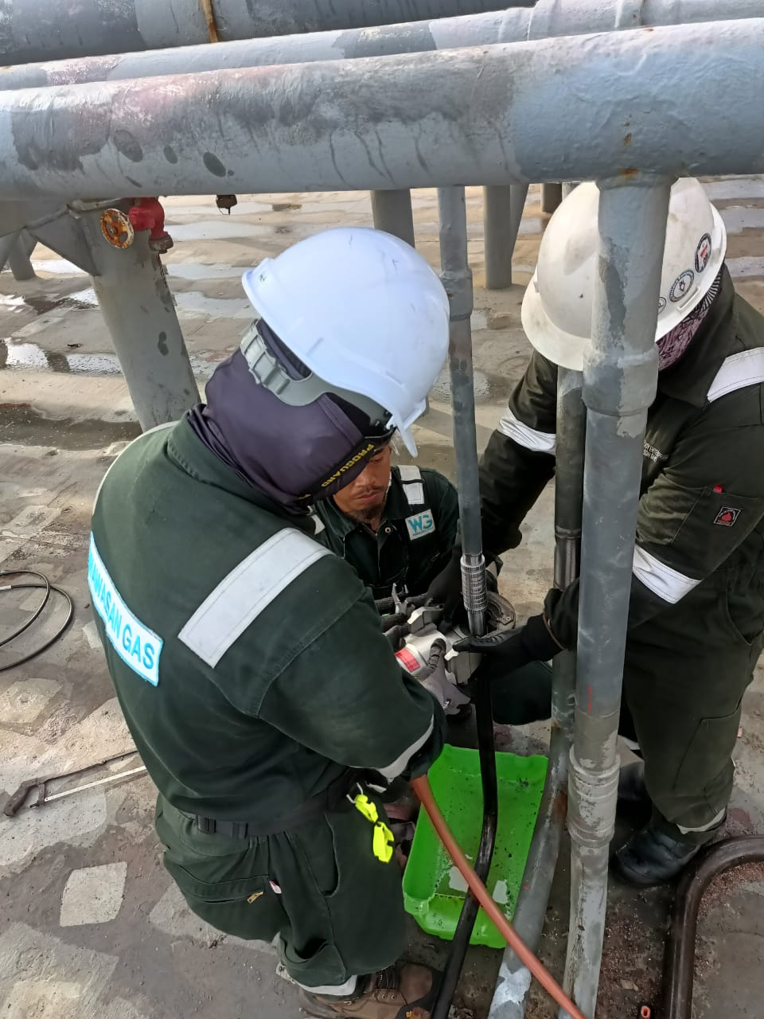
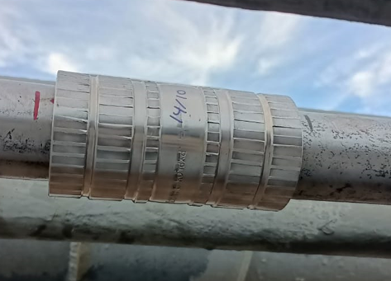
PERTAMINA PIS PIONEER OIL TANKER REPAIR - MMHE
8TH OCT – 19TH OCT 2022 - 85 FITTINGS (Coupling, Tee, Reducer)

Slide 7
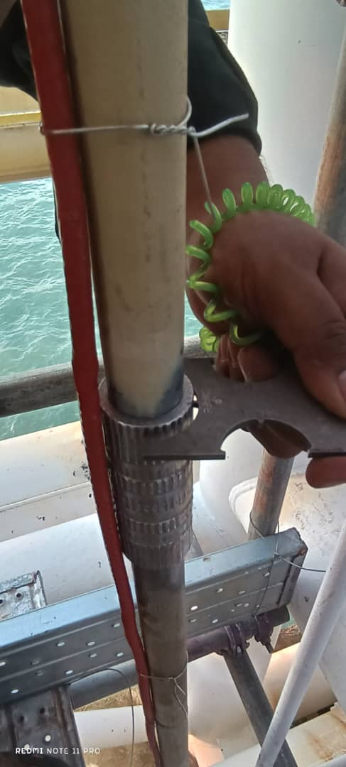
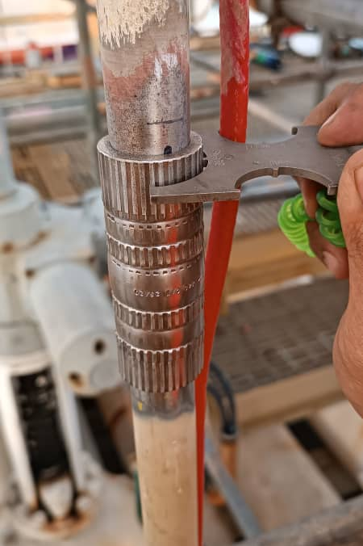
MRCSB Turnaround Service Contract 2024
Installed Pyplok fittings, Carbon steel for steam & hydrocarbon line at Petronas Malacca, MRCSB for sizes 2”, 1 ½” , 1” and ¾” since 2019

Slide 8
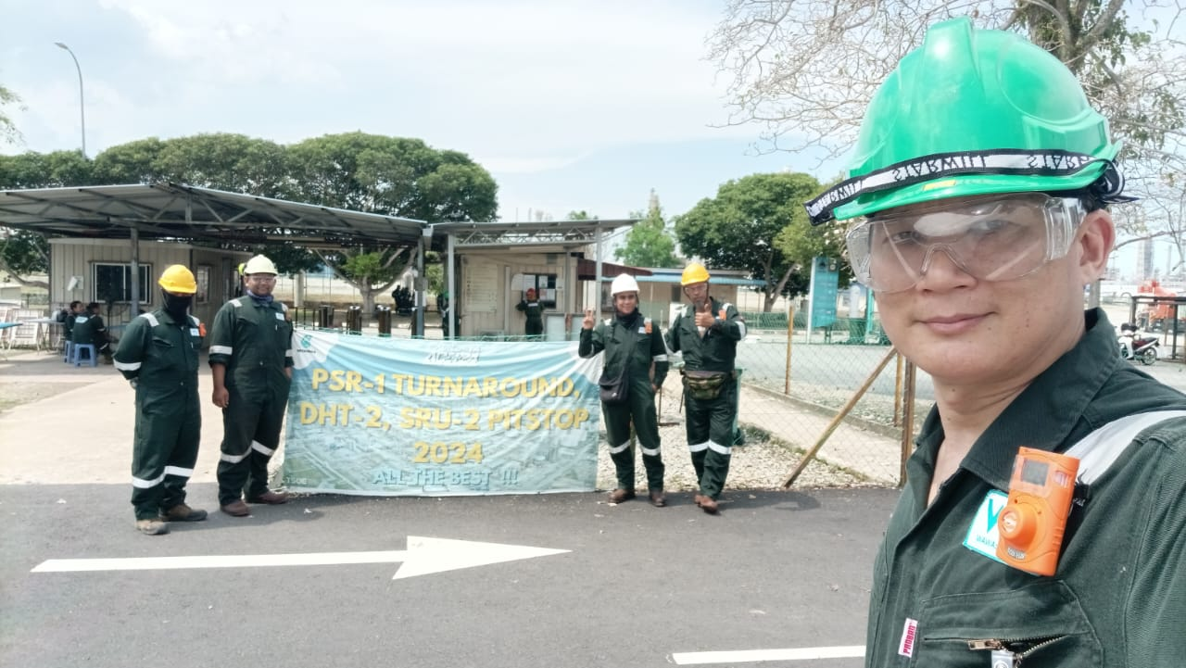
MRCSB Air Piping Line Expansion
Installed 2” Pyplok fittings, Carbon steel for Compressed Air line in MRCSB with 30 pcs in 4 days.

Slide 9
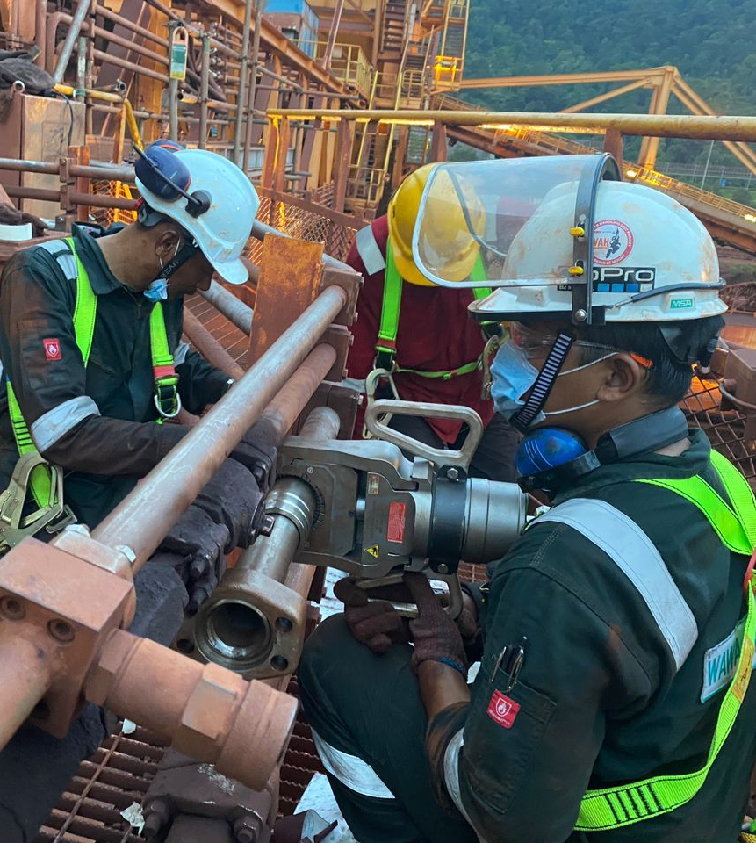
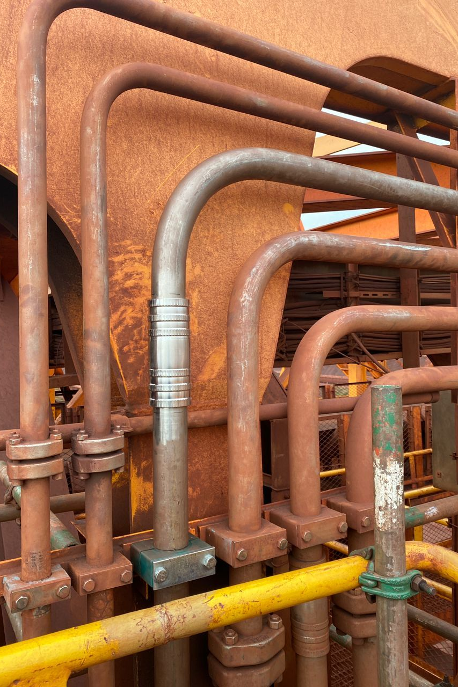
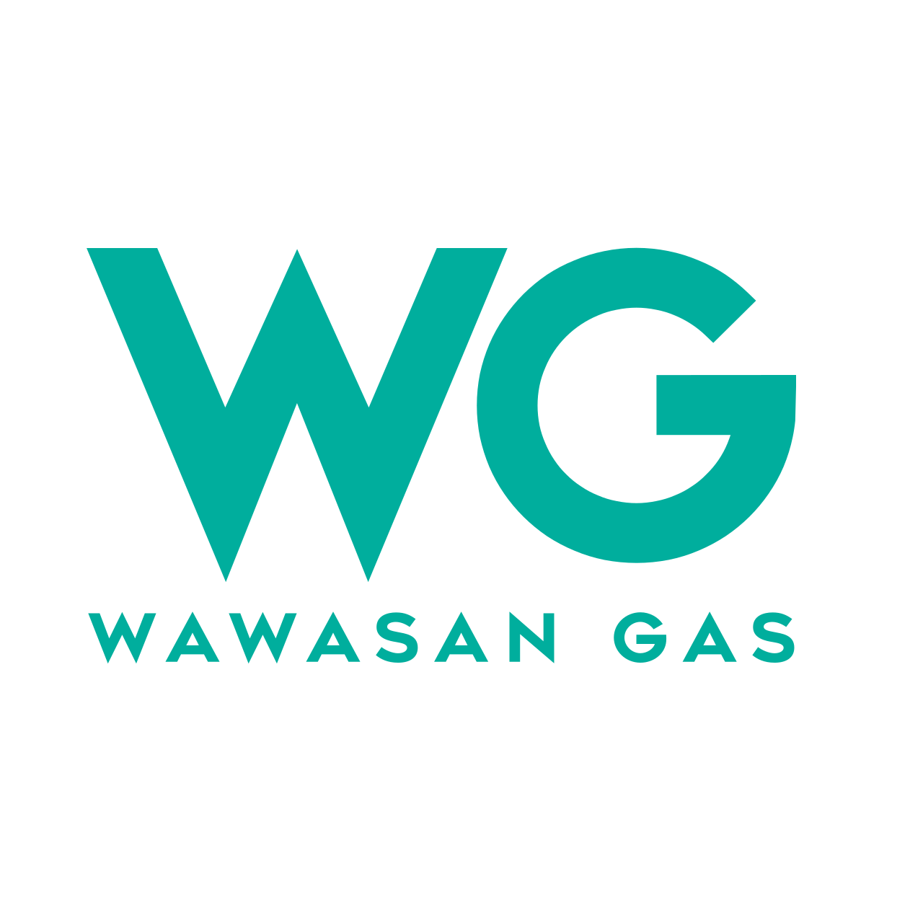
Pyplok Installation Works
Duplex material – 2” & 1 ¼” for Hydraulic Line since 2019

Slide 10
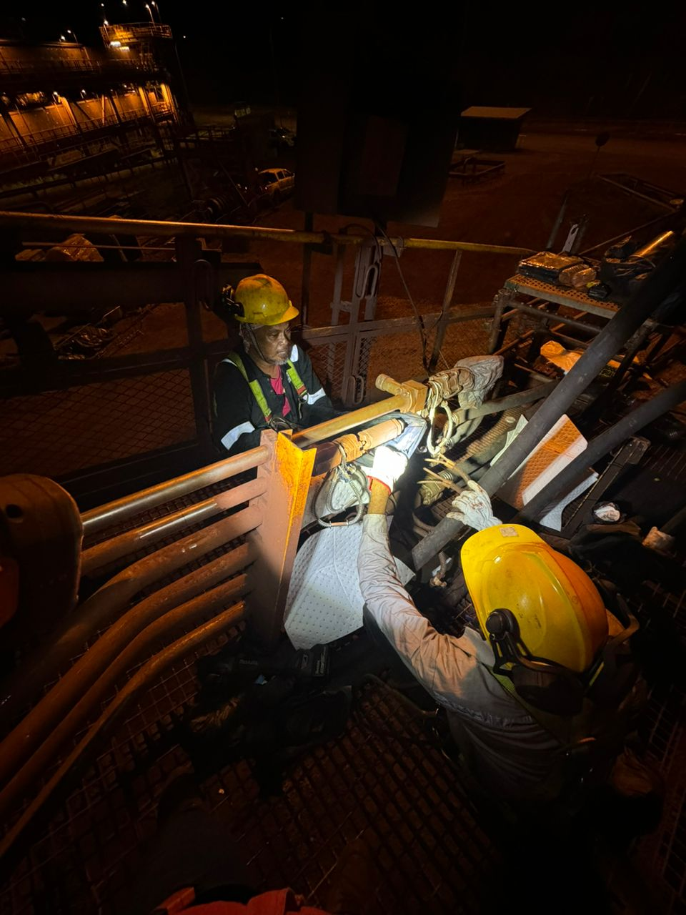
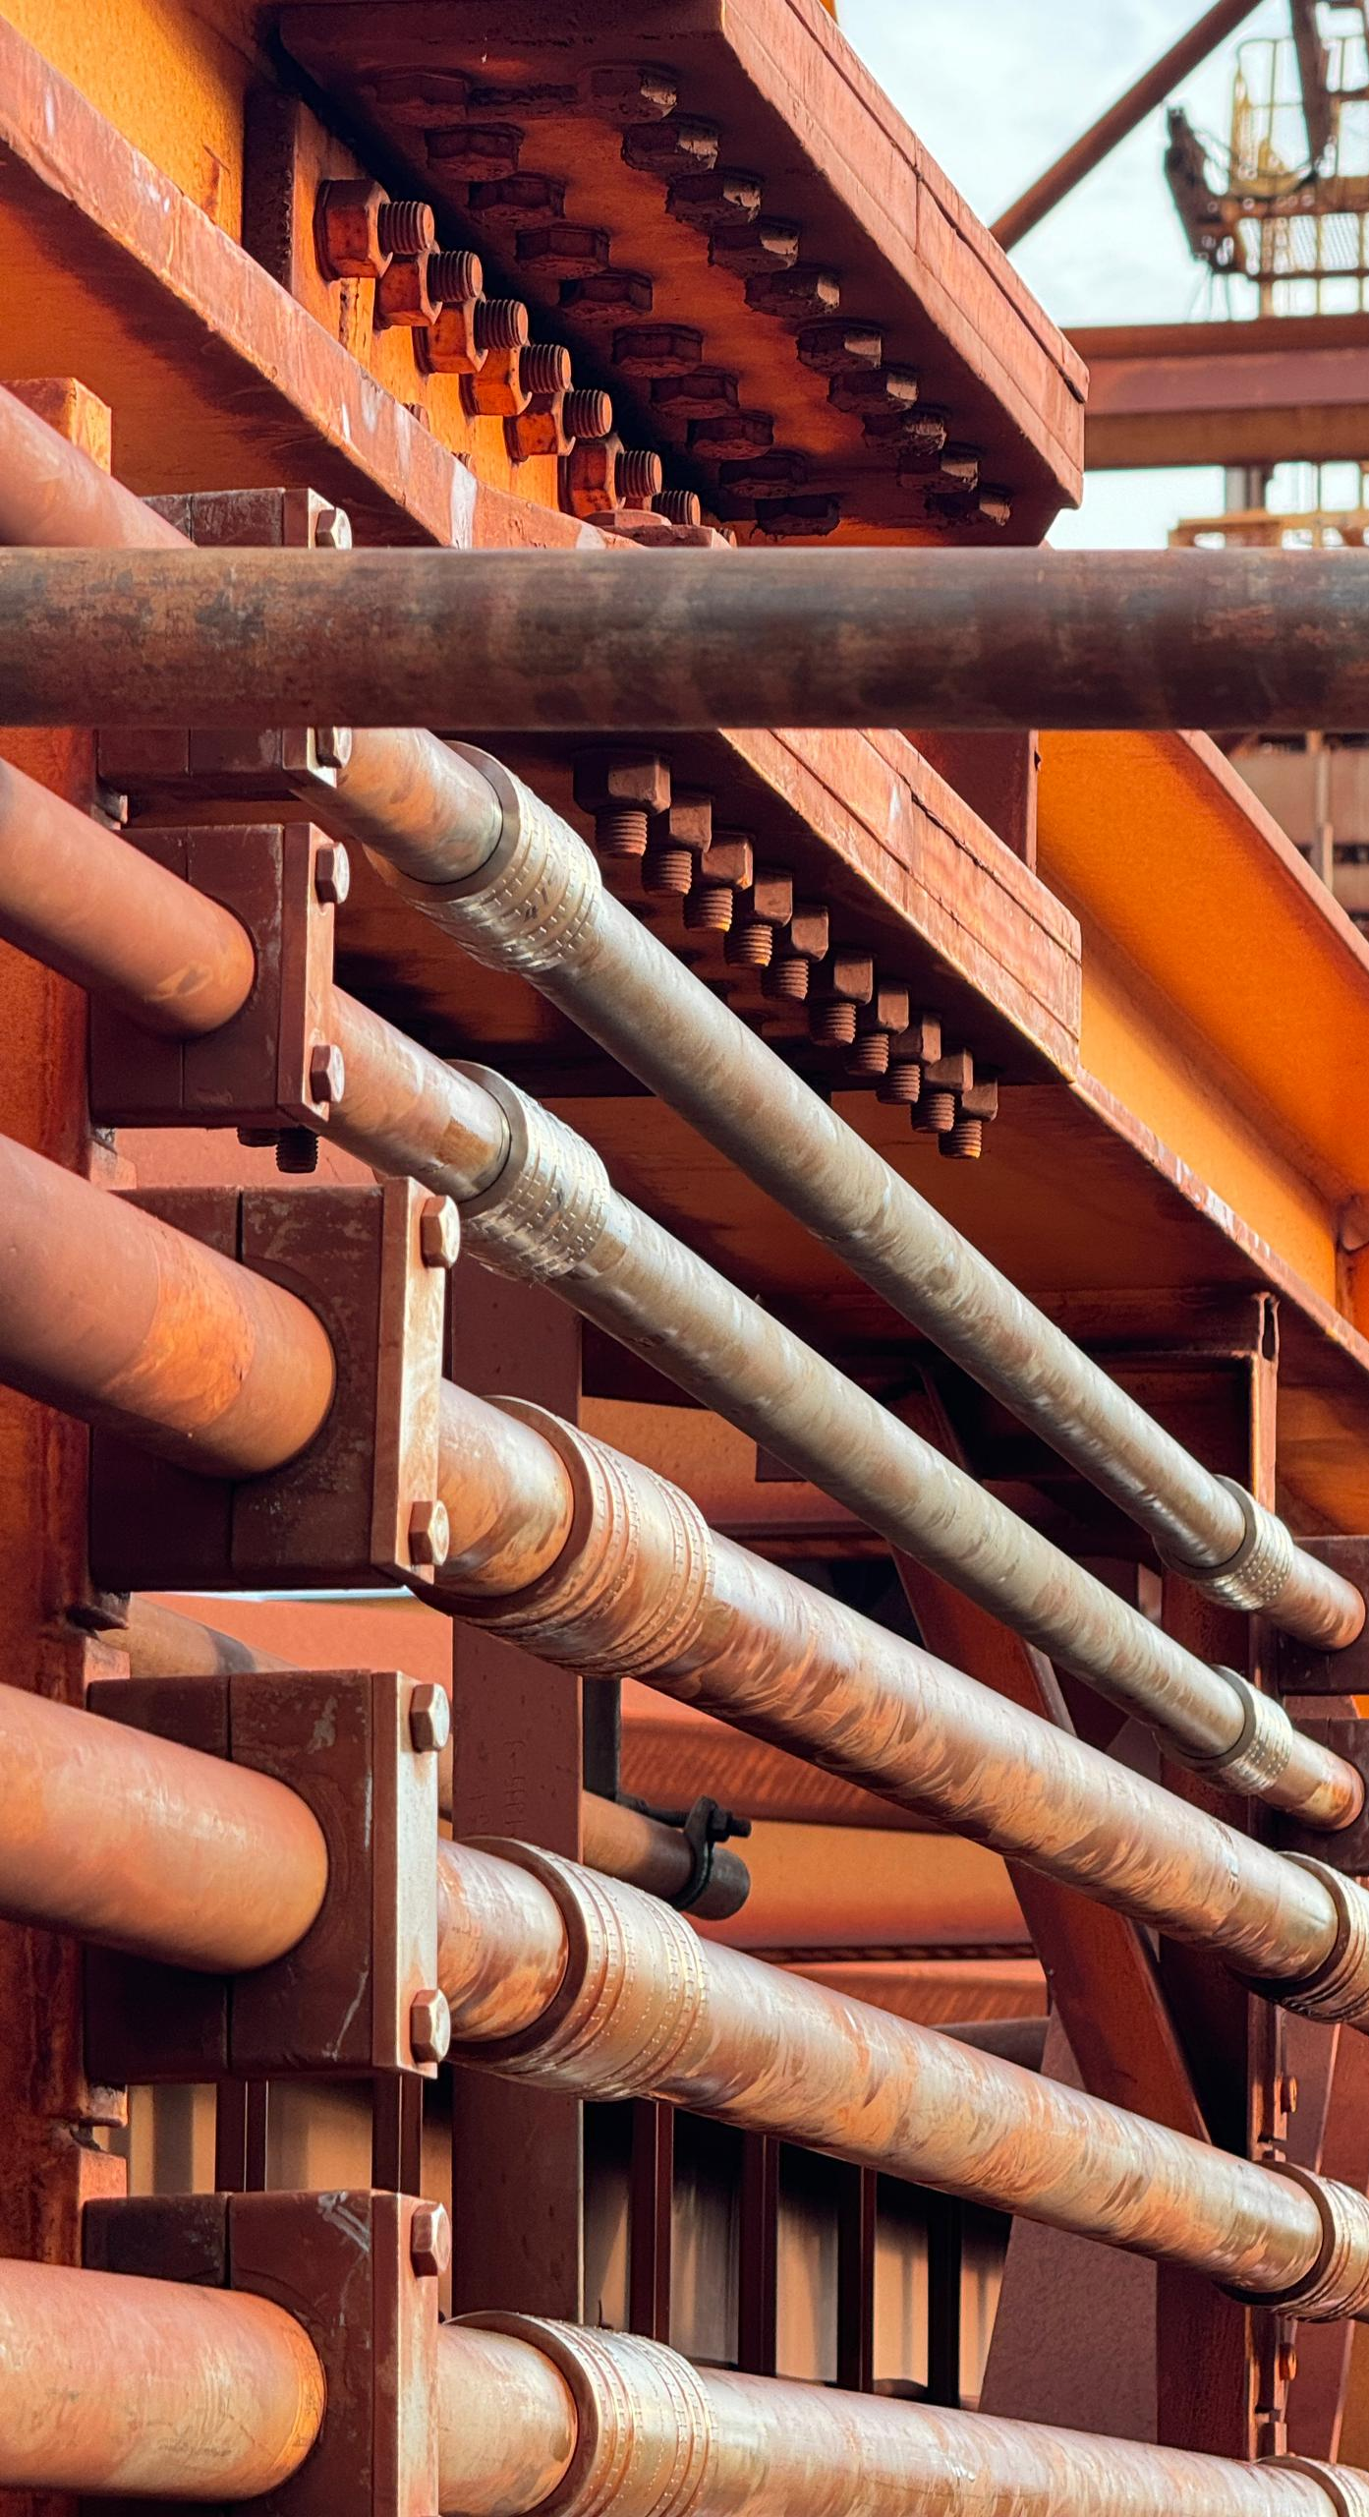
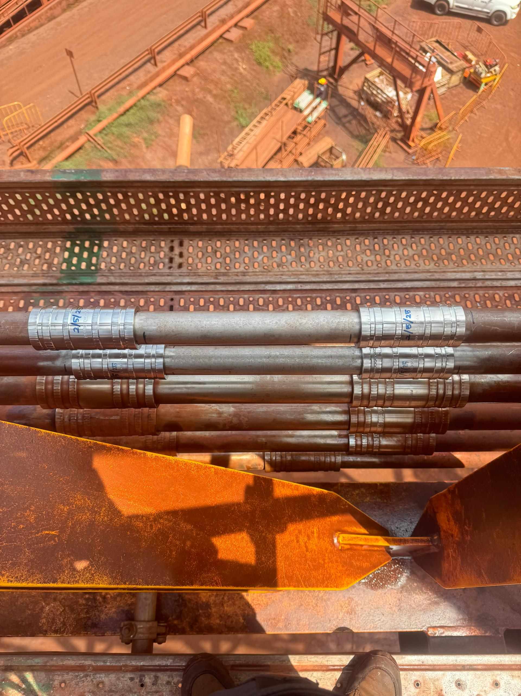
Vale Pyplok Fittings Installation:

Slide 11
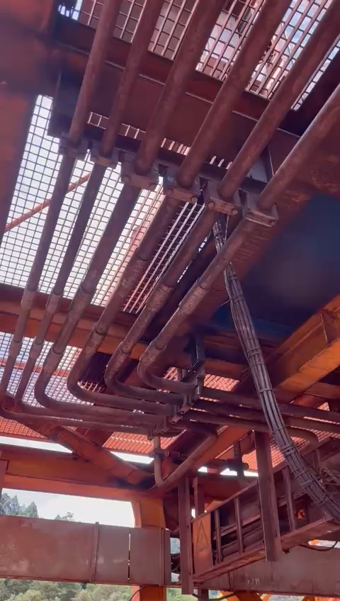
Vale Pyplok Fittings Installation

Slide 12
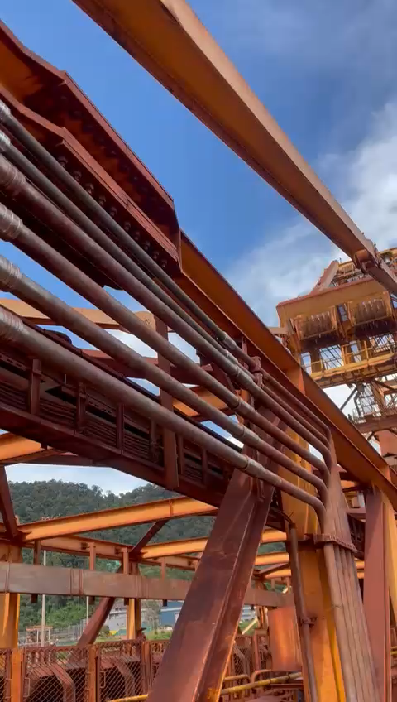
Vale Pyplok Fittings Installation:

Slide 13
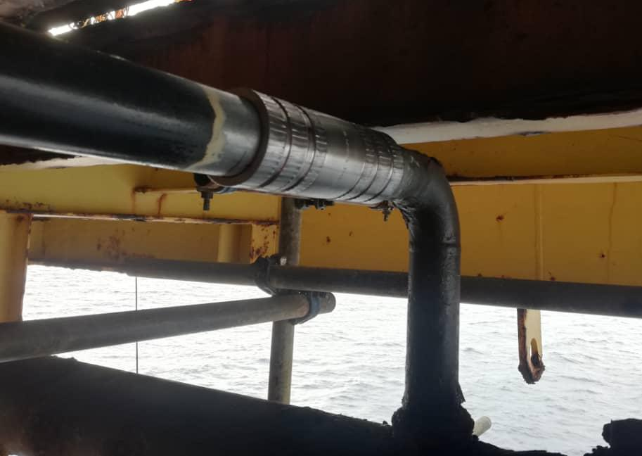
Hibiscus Malaysia Utility Line
Installed Pyplok fittings, Carbon steel for utility line at Hibiscus Malaysia Platform

Slide 14

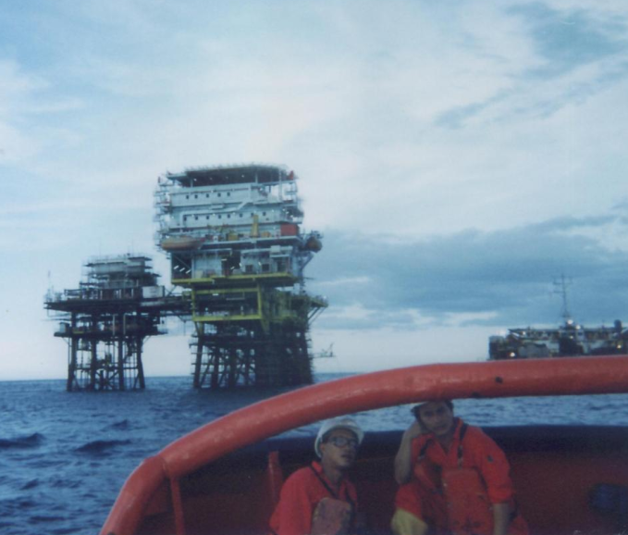
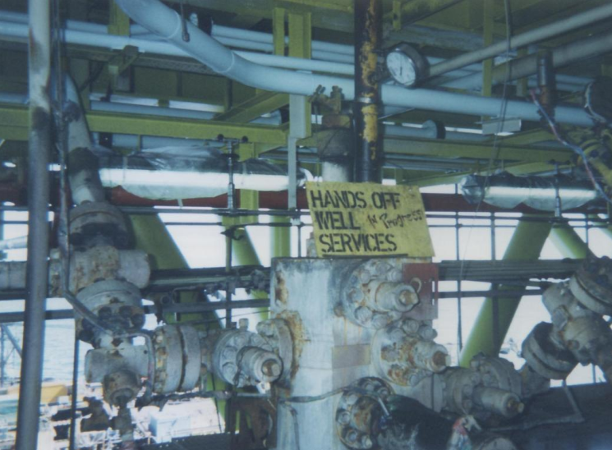
In Shell Sarawak
South Furious Offshore Drilling Platform
Year of Installation – 1994
Pipe Sizes – ½” NPS, 1” NPS Sch 80
Line – Instrumentation Manifold
Operating Pressure – 100 psi
Material – Stainless Steel

Slide 15
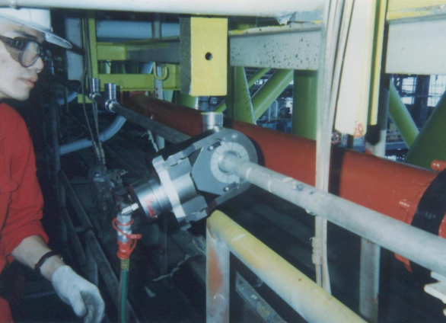
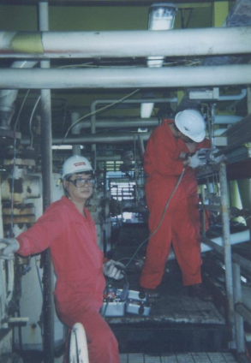
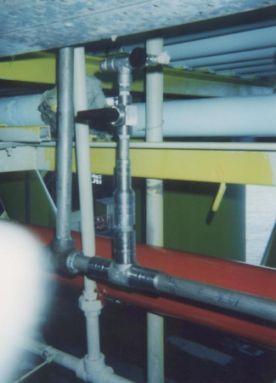
In Shell Sarawak

Slide 16
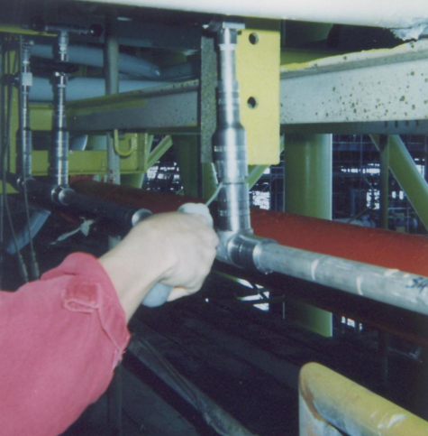
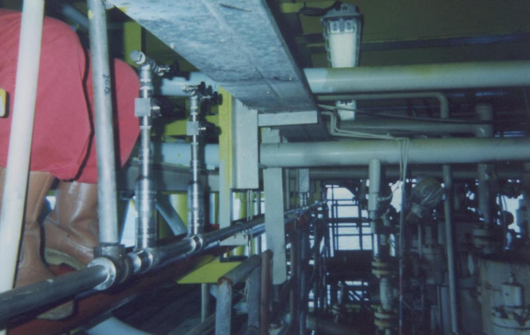
In Shell Sarawak
Leak Testing
Completed Line

Slide 17
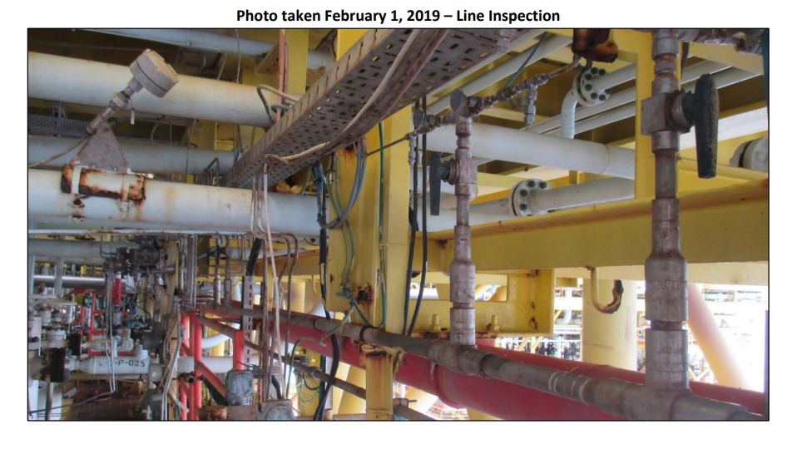
Now is SEA Hibiscus…

Slide 18
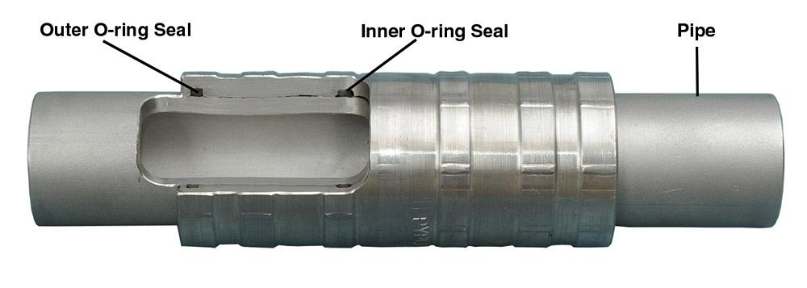
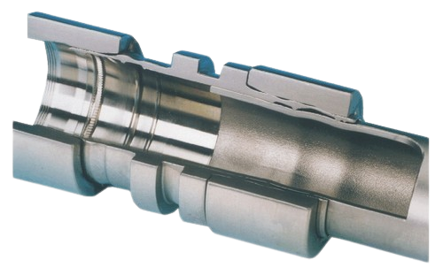
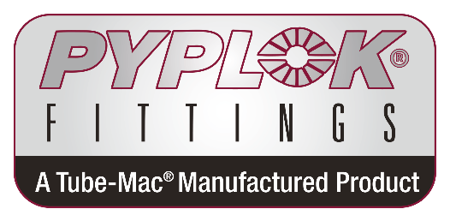
Metal to metal
Seal
Technical Comparison:
VS
O-ring Seal
Cracks grow longitudinally from crevice corrosion sites through the driver ring due to tensile hoop stress
Inboard Seal
Outboard Seal
Main Seal
Driver Ring
Crevice where chlorides are believed to have collected and corrosion initiated

Slide 19
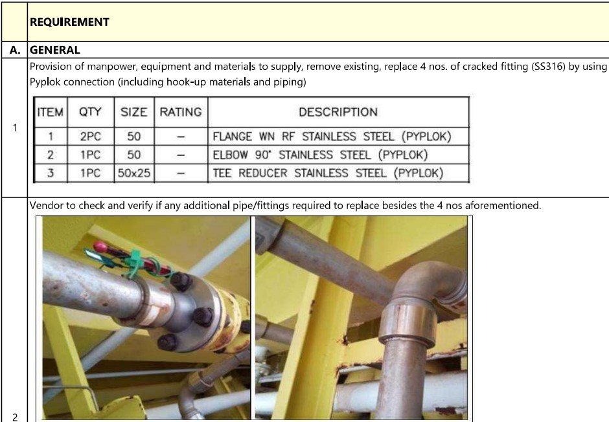
Replacement by Pyplok at Shell Platform

Slide 20
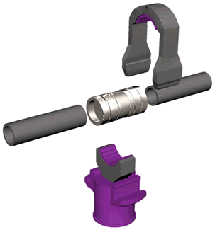
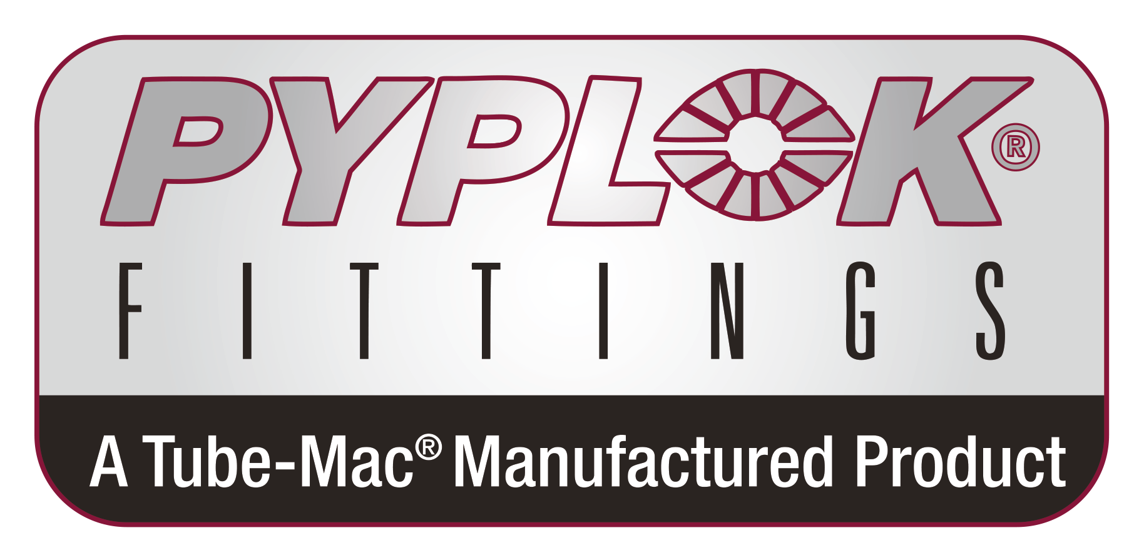
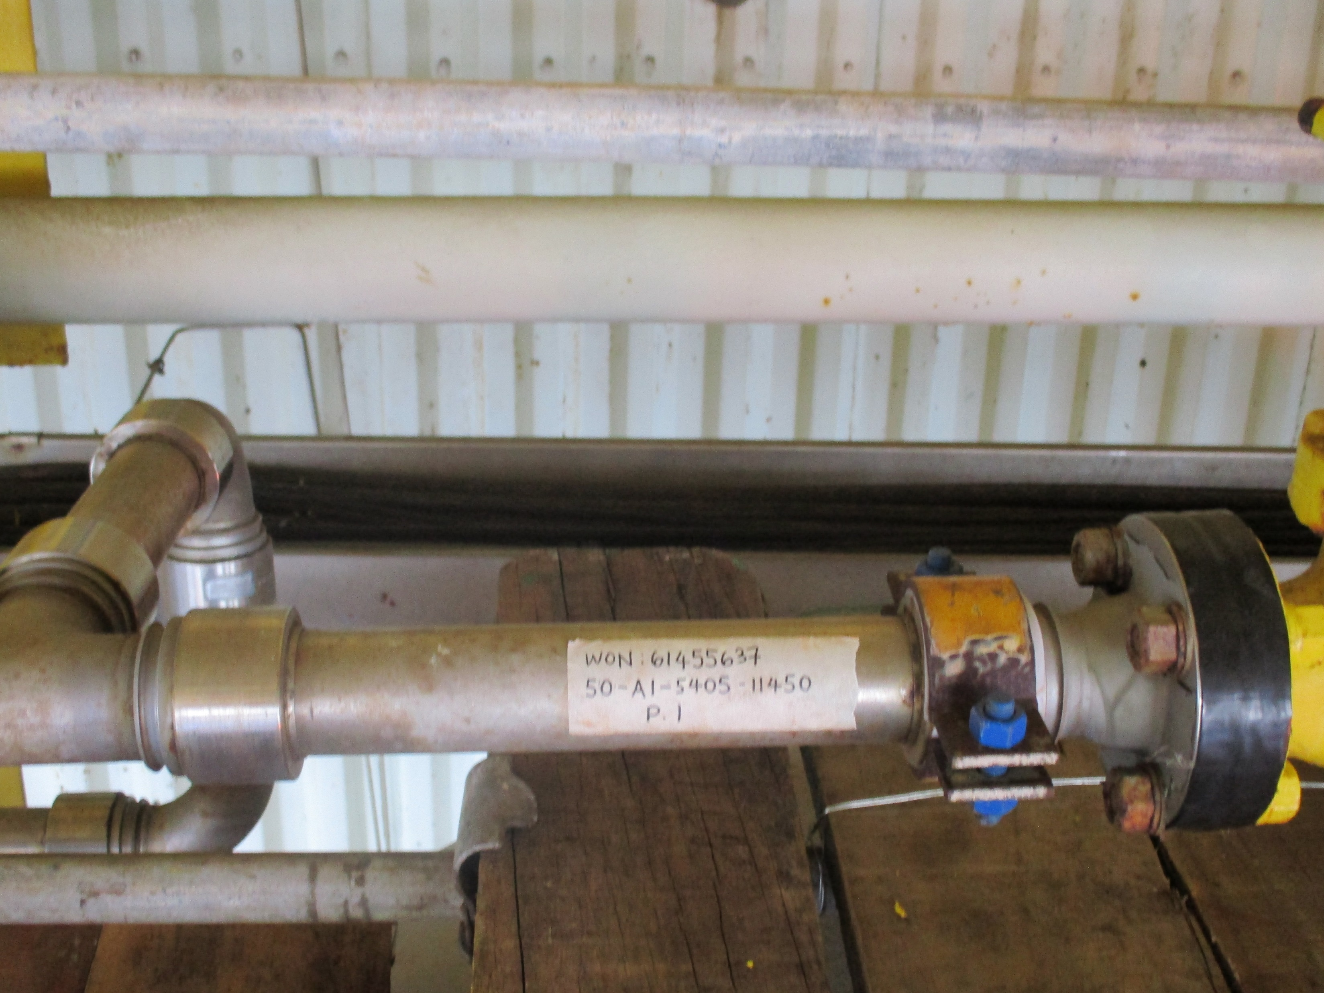
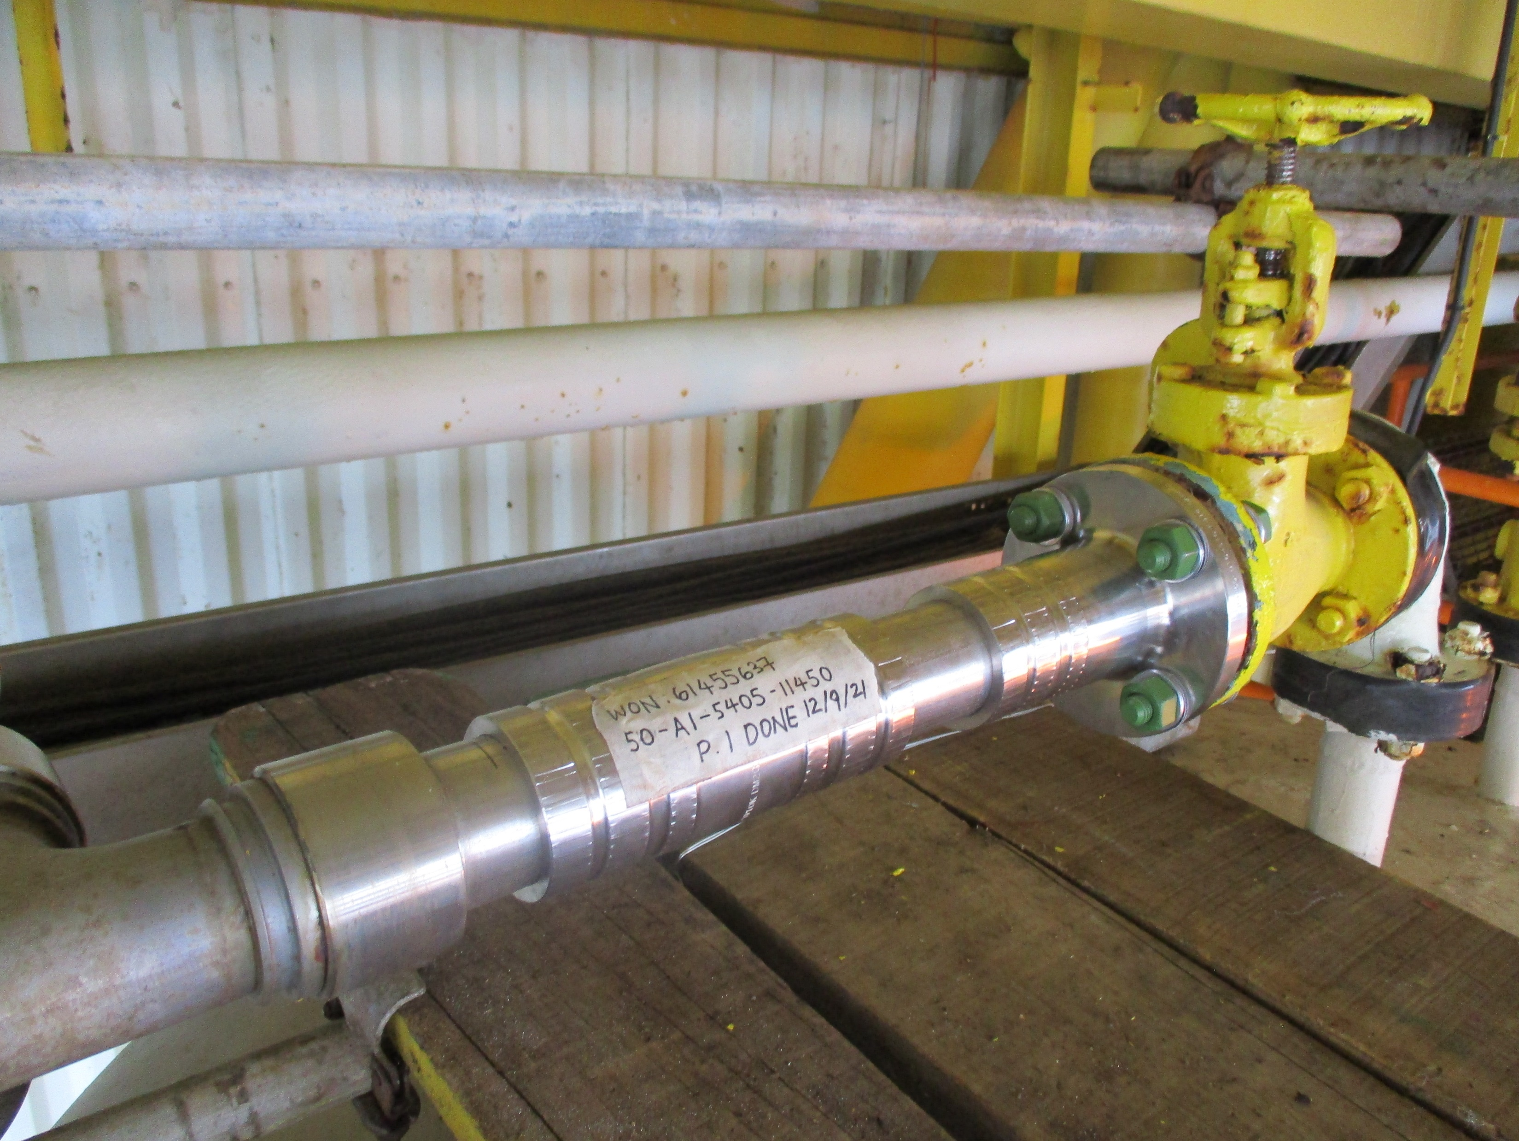
Replacement by Pyplok at Shell Platform
Before
After

Slide 21
Company Direction & Strategy
Direction – become a total solution provider
Market Focus
    Oil & Gas, Marine, Power, Data Centre & General Industries
Strategy – 3 main focuses
    Technical comparison between O-ring seal versus metal-to-metal seal.
    Continue to provide best support to existing loyal customers.
    Work out Price and Service Agreement with end-users.
Total Labour and Material

Slide 22
Main Challenges In Malaysia:
Lokring is influencing clients to stick to metal to metal seal since O-rings can fail due to heat hardening and oxidation damage.
Bonlok had convinced Oil & Gas end-users to put 6” fittings into the tender specification of service contract since they can make it nowadays.
Customers is preferred with manufacturer who can offer comprehensive solutions in terms of fittings’ size & temperature.
Total Labour and Material

Slide 23
Q & A
Total Labour and Material

Slide 24
Thank You for your precious Time!

