Slide 1

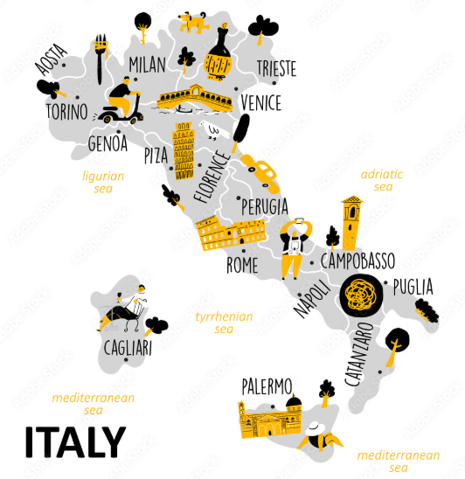

Slide 2
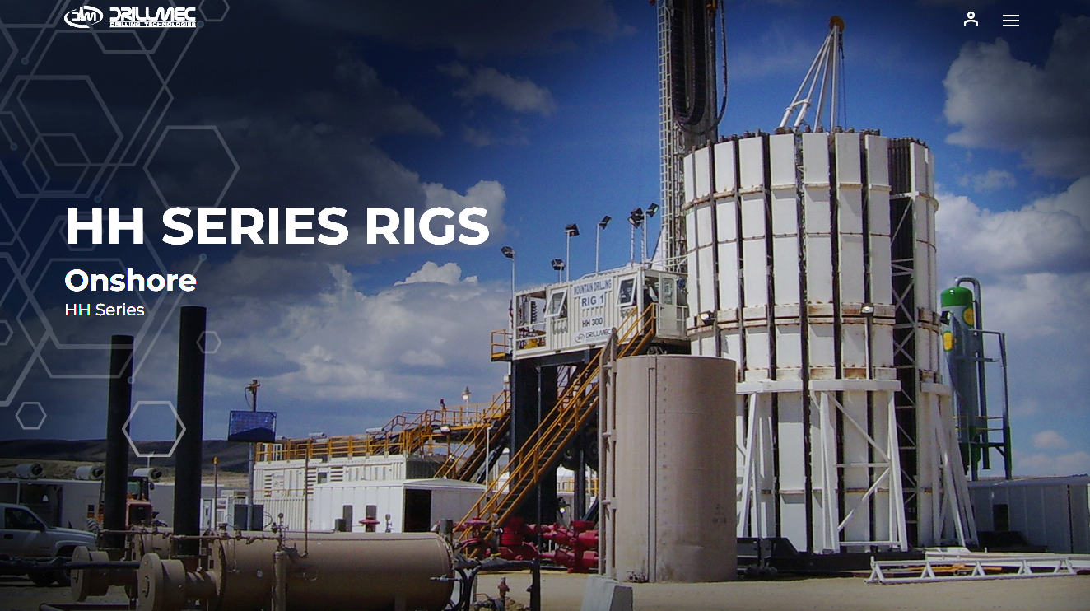
Key Account : DRILLMEC

Slide 3

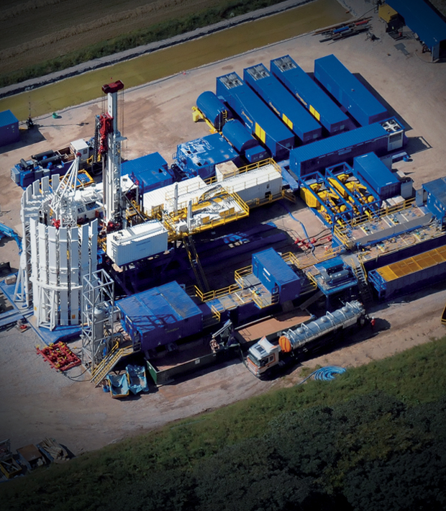
HH SERIES ONSHORE RIGS
HH Series is a semi-trailer and MAST
Self-erecting hydraulic telescopic MAST built-in the top drive.
The HH Series creates a smaller footprint
Major rig components are permanently mounted to semi-trailers for fast rig-up or down for transportation between drill sites.
Tube-Mac pre-engineered piping system copes with the request of supplying a compact and optimized design of the hydraulic on the rig.

Slide 4
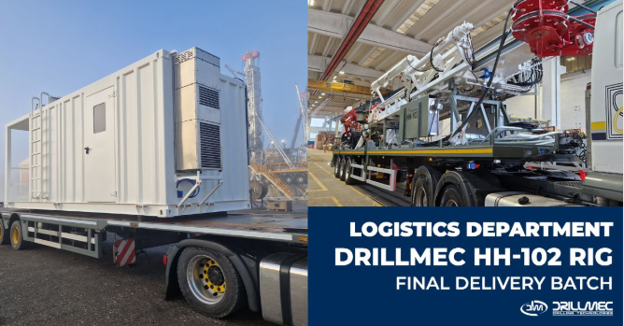
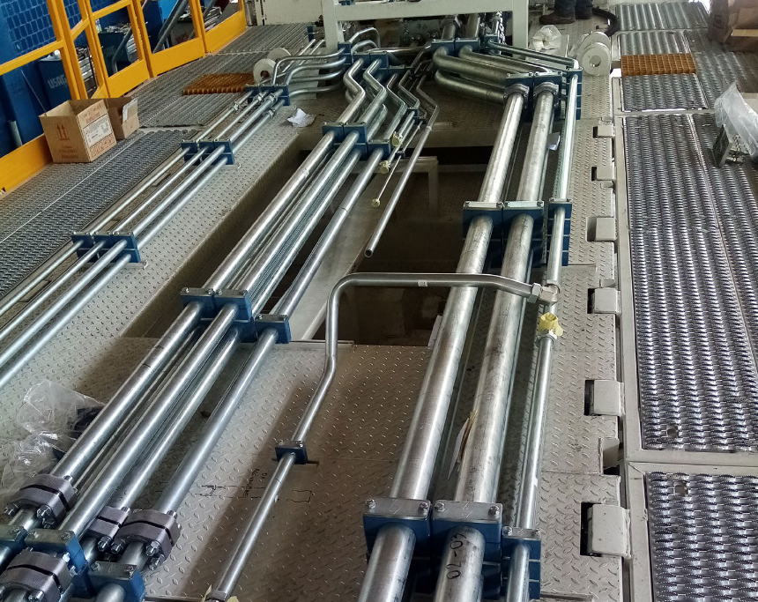
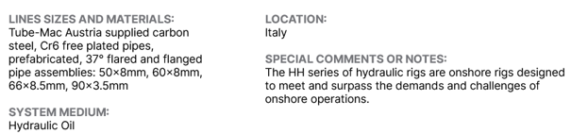
DRILLMEC - HH102

Slide 5
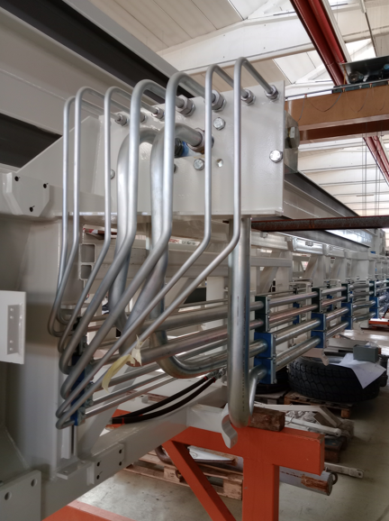
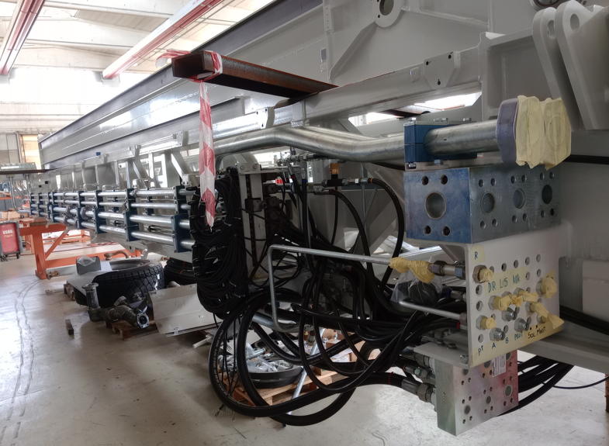
DRILLMEC - HH150

Slide 6
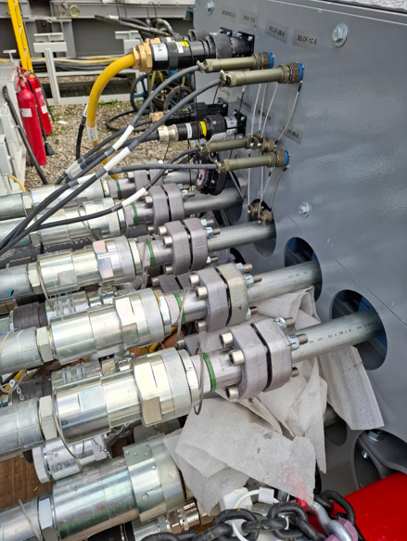
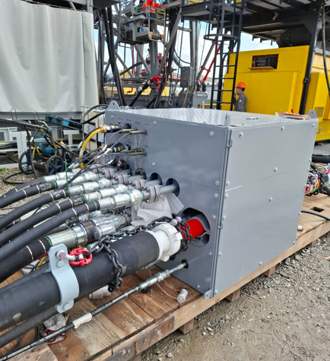
DRILLMEC HH102 Customers ENEL and Carbfix
Scope of Supply:
Prefabricated Pipe Assemblies with TMI 37°Flare Flanges for trailer and mast.
The pipe sizes 90x3.5mm, 50x6mm, 60x3mm and 66x8.5mm
Machine type:
Kit 1: End customer ENEL, largest oil and energy company in Italy
Kit 2: End customer Carbfix, carbon capture segment

Slide 7
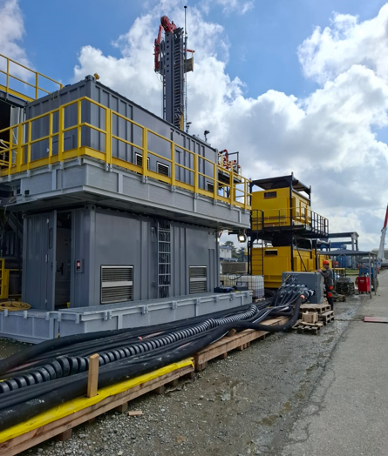
DRILLMEC HH102 Customers ENEL and Carbfix
Type of hydraulic piping systems:
Skidding System
Bop lifting
Catwalk
Side loader (drilling pipes manipulator)
Pipe Bean (drilling pipes loaders)
Power tong
Torque wrench
Casing
Top drive

Slide 8
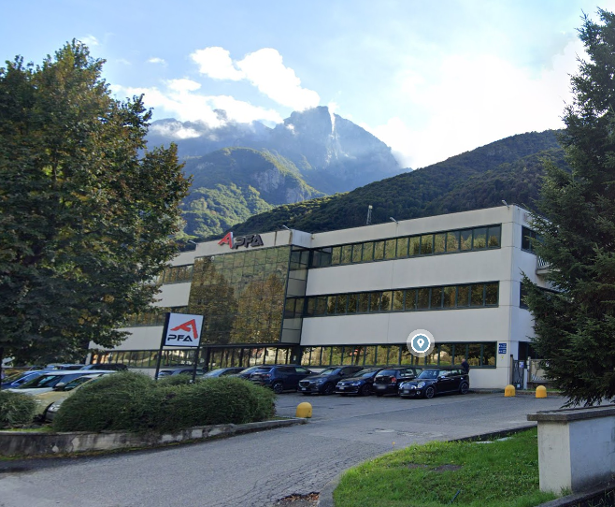
PFA Aluminum Extrusion Company

Slide 9
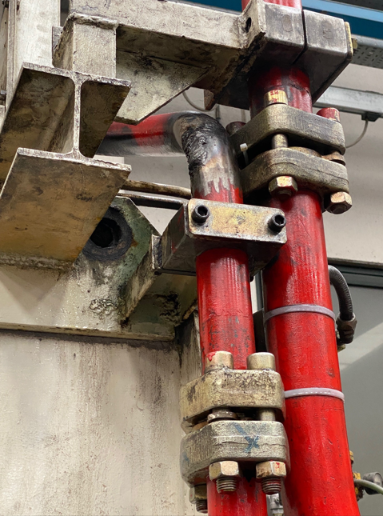
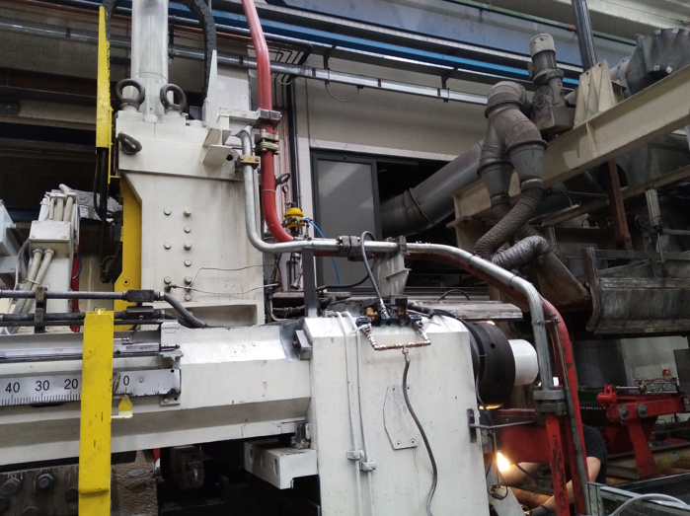
PFA Aluminum Extrusion Company
Shear Pipe Replacement
Before – several attempts to repair the pipe by welding.
After – TMI 37°Flare Flange 60 x 6mm pipe to replace the entire line.

Slide 10
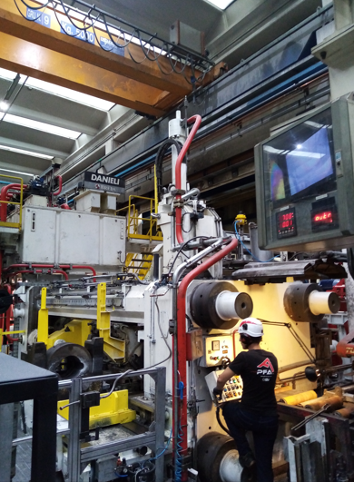
PFA Aluminum Extrusion Company
Shear Pipe Replacement

Slide 11
Thank you, Grazie!

