Slide 1
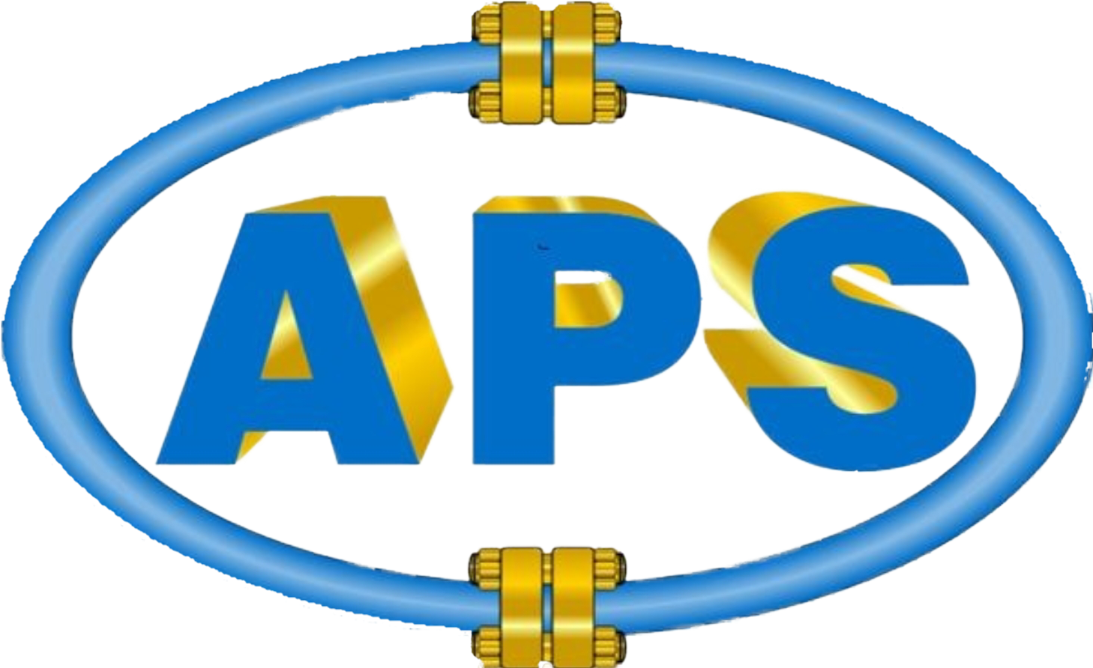
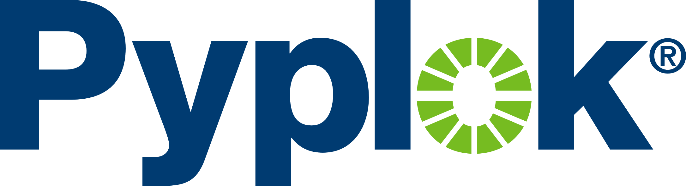
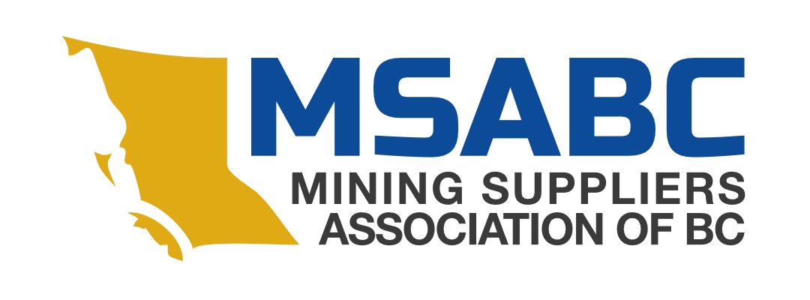
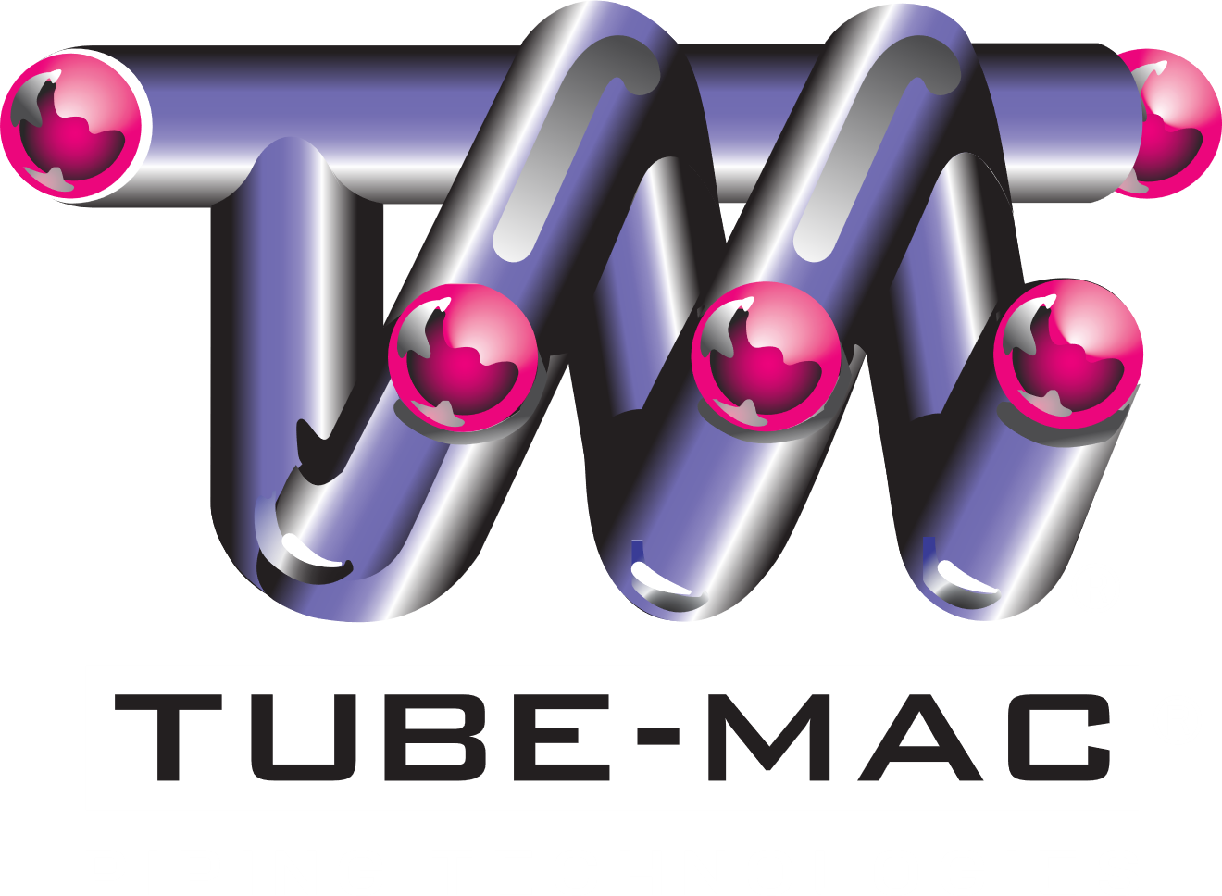

ADVANCED PIPING SYSTEMS
Proudly serving Western Canada
Nisku, Alberta
Vancouver, British Columbia

Slide 2
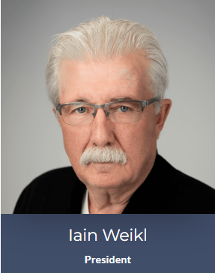
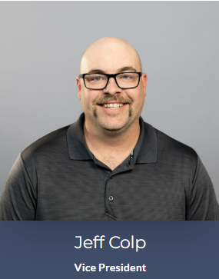
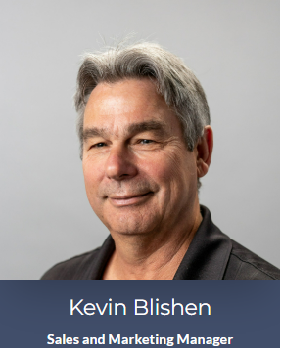
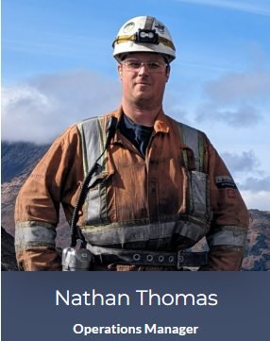
Introducing Our Team

Slide 3
Key Projects Featuring Pyplok
City of Calgary Bus Barns
EVRAZ Pipe Threader, Red Deer
Brandt Group of Companies, Canada

Slide 4
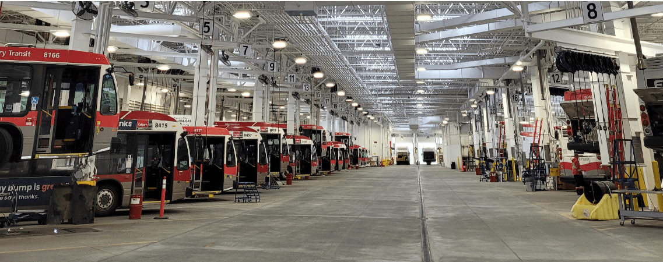
City of Calgary Bus Barns project
Project Completed 2019
17,000 FT of Tube-Mac Piping
1750+ Pyplok Fittings

Slide 5
City of Calgary Bus Barns project
Project Timeline - 10 Months
Installation of 1”, 1-1/2”, and 2” pipe and fittings
Carbon steel and Stainless-steel
Engine oil, Transmission oil, Antifreeze, High pressure grease
Successful Bid against Swagelok and Welded options

Slide 6
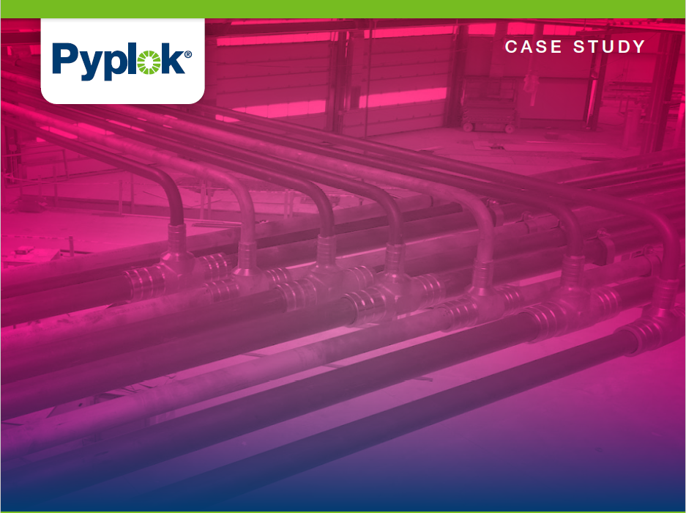
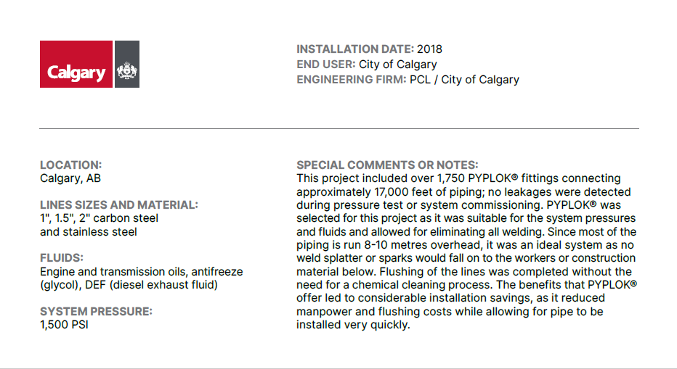

Slide 8
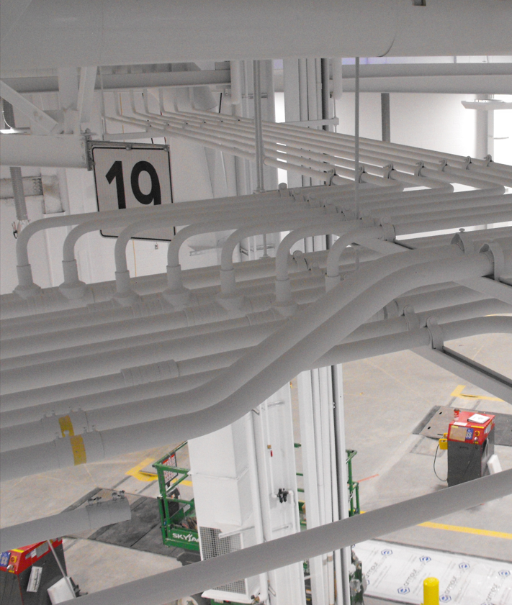

Slide 9
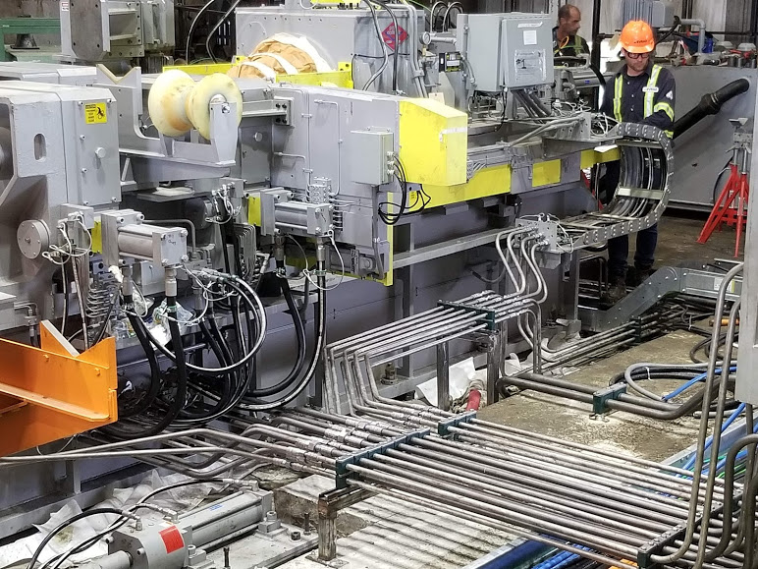
Evraz pipe threader, alberta
- Installation Completed 2020
- 3500 FT OF Tube-mac Piping
250 Pyplok Fittings ½”, 1”, 1-1/2”
Completed in Partnership with
Tube-Mac Projects Team

Slide 10
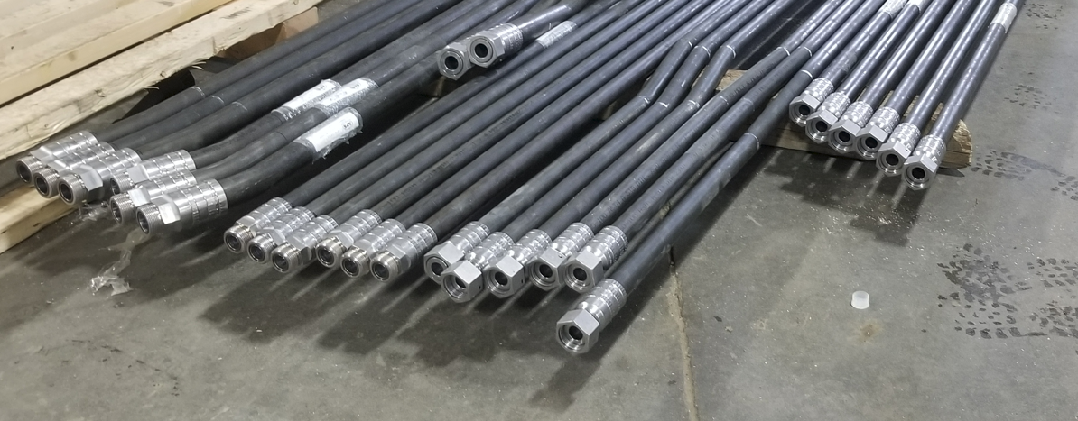
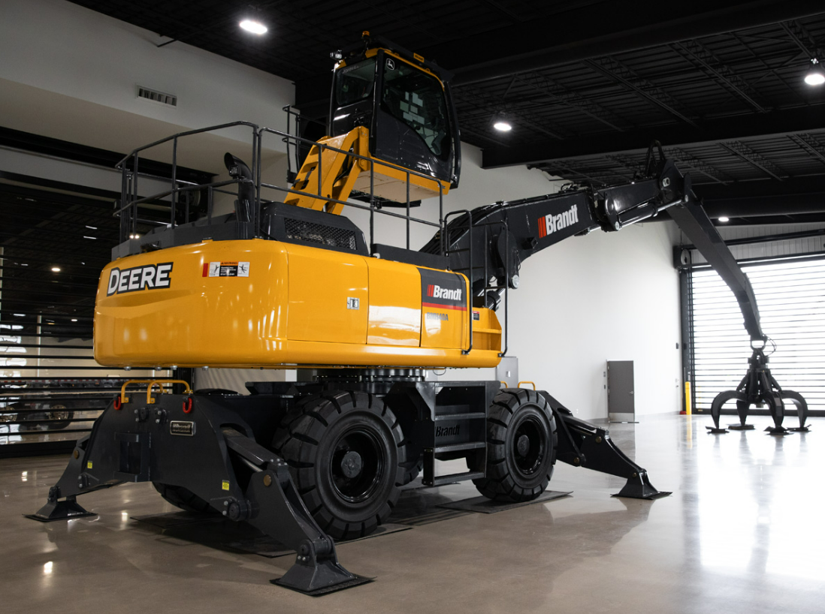
Brandt group of companies
Ongoing contract for Canadian built material
handlers
- ½”, 1”, 1-1/4” 5000 PSI Sch 80 hard lines
- O-ring Face Seal Pyplok
60+ pipe assemblies per month built and tested in
Nisku facility

Slide 11
Strategic Goals and Upcoming Projects
Mining Projects – Western Canada
Fluid Powerhouse Partnerships
Delta Port Potash Expansion – British Columbia
Aquaculture Developments – British Columbia
Drilling Rig Top Drive Systems
Commercial Construction Installations

